Slide 1
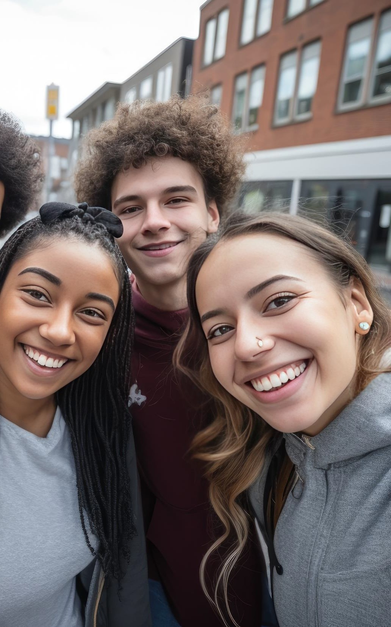


School of Eastern Finland
Imatra · Joensuu · Lappeenranta

Slide 2

CONTENTS
Who we are
One school, three stages
Upper secondary school
Upper secondary school studies: modules and everyday essentials
Cooperation and our role in society
Facts and figures
What makes families choose us

Slide 3

WHO WE ARE
We are an international school
We are a private school that follows the Finnish national curriculum. Our school operates in three towns: Imatra, Joensuu and Lappeenranta. Around 620 children and young people learn with us, from preschool through upper secondary school, supported by 50–60 staff members. We are the only school of our kind outside Finland's capital region.
We are a safe community
We are a flexible, caring community from pre-primary education onwards. A pupil grows up with the same classmates from pre-school – all the way to upper secondary school. Moderate class sizes and caring adults create a safe school environment and individual teaching. Every teacher knows every pupil and family. We are a safe, close-knit school. We have genuine will and means to help learners from multicultural families settle into Finnish society.
We are a bold pioneer
We look ahead with open minds and a spirit of renewal. We want to live in the moment and think big. Our motto says it best: The world begins with us.
Our learners succeed
Through varied activities, our pupils and students have the chance to grow into creative, courageous, self-driven and enterprising people. We are raising the experts of tomorrow, with excellent readiness to work internationally.

Slide 4
ONE SCHOOL, THREE STAGES
School of Eastern Finland offers one continuous learning path made up of three stages, built around:
  early childhood education
  basic education, grades 1–9
  and upper secondary school.
Across all three stages, we place special emphasis on:
  developing strong Russian-language skills
  building a safe, caring community
  continuing to grow in Imatra, Joensuu and Lappeenranta.
Teaching increasingly emphasises quality and continuity from the very first years.
We want to be:
  the best place to learn.
  the best place to work.
We build our reputation by strengthening our partnerships

Slide 5
Upper secondary school
Focus | What this means | Key facts
Founded in 1997 by state and local authorities | The only language school of its kind outside the Helsinki capital region | Born from → regional language needs Campuses in Imatra, Joensuu and Lappeenranta, each shaped by its own local Russian-speaking community.
114 upper secondary students | Alongside 450 in elementary and secondary school, 23 in preschool and 33 in preparatory education for upper secondary studies | 56% → speak Russian as their native language
Two strong languages: Russian and English | Every student studies A-level Russian or Russian as a mother tongue, and compulsory A-level English | 6 compulsory + 6 in-depth Russian courses → every year group
A full study plan | The minimum study plan consists of 75 courses in total | 49–53 compulsory → plus in-depth and applied courses At least 12 in-depth courses; one course contains 38 lessons. Students follow their own individual study plan.
Also studied: Swedish and optional languages | Swedish is compulsory for everyone — 5 courses, at B1 or B3 level. Optional languages include Spanish, Italian, German and French. | Study trips abroad First year: a week in Bratislava, Slovakia. → Second year: a week in Budapest, Hungary or Warsaw, Poland.

Slide 6
Upper secondary school studies: modules and everyday essentials
Focus | What this means | Key facts
One language pathway, from day one | The same emphasis on Finnish, Russian and English runs through every stage From the very first grade: Finnish and/or Russian as mother tongue; Russian or Finnish as the 2nd language | English begins in grade 3, Swedish → from grade 7
Optional languages | German, French, Spanish and other optional languages from grade 8. Other languages may be added in upper secondary school | Choice of languages → grades 8 onward A-level Russian or mother tongue: 6 compulsory + 6 in-depth courses English: 6 compulsory + 2 in-depth/applied courses
A-level and mother-tongue tracks | Every student reaches an advanced level in both Russian and English. | Swedish: 5 compulsory courses → choice of B1 or B3 level
75 courses in total | 49–53 compulsory, 12+ in-depth, plus applied courses | Individual study plans → throughout all three years
Learning continues outside the classroom | Trips run throughout school, from Estonia in grade 6 to Italy, Estonia or Latvia in grades 7–9. Upper seconday school trips: Bratislava in year one, Budapest in year two. | A week abroad in both years of study trips

Slide 7
Cooperation and our role in society
Focus | What this means | Key facts
Growing our reputation | We want to be a recognised player across Finland | Building the right networks. Taking part in public discussion.
School–business network | Live Russian-language teaching for upper secondary school students, delivered from our remote studio. Developing entrepreneurship education. Growing the importance of financial literacy. | Ongoing
Sharing our teaching | Tailored Russian, Finnish and other language teaching for other schools | About 200 small upper secondary schools across Finland
Cooperation across our three towns | Growing cooperation brings new entrepreneurship elements, more Russian and Finnish language teaching, and more demand for internship places | Local partnership networks → autumn 2026 Different forms of entrepreneurship. Growing financial literacy. Starting a business.
Strong Russian-language experts | Growing the value of Russian-language skills and raising their profile in public debate

Slide 8
Facts and figures
Founded in 1997
Established by state and local authorities to meet the region's own language needs.
The only language-focused school outside Finland's capital region.
A private school that follows the Finnish national curriculum, working closely with three local communities.
Selective admission
Three towns, one school
Around 620 children and young people study with us: 450 in elementary and secondary school, 114 in the upper secondaty school, plus preschool and preparatory education.
Campuses in Imatra, Joensuu and Lappeenranta, with pupils able to stay with the same classmates from pre-primary through to the lukio.
Our results
First matriculation-exam graduates in 2004. More than half of our upper secondary school students speak Russian as their native language.

Slide 9
What makes families choose us
Highlights
One continuous path from pre-primary all the way to upper secondary school, in the same community
Small, personal school units where every teacher knows every pupil and family
Specialised Russian language and culture teaching — the only school of its kind outside the Helsinki region
English studied from grade 3, and Swedish and other languages added as students grow
Real international experience through study trips — including a week in Bratislava and a week in Budapest during the lukio
Practical entrepreneurship education, developed together with local companies and universities
A caring, safe community that helps multicultural families settle into life in Finland
A private school that follows the Finnish national curriculum, working with state and local authorities
Selective admission
’114 lukio students working toward the Finnish matriculation exam, on a full 75-course study plan
Graduates who go on to study and work all over the world

Slide 10

The world begins with us.

